Slide 1
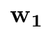
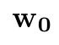
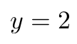
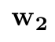
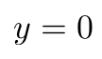
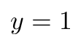


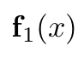
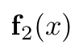

binary classification
multi-class classification

Slide 2
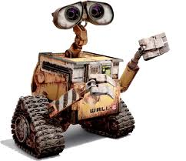
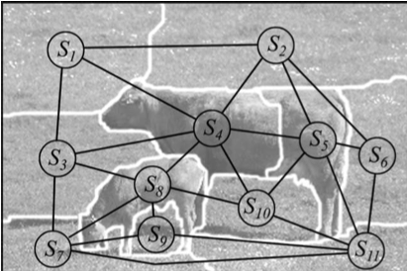
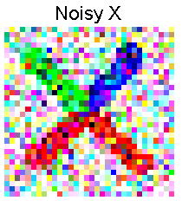

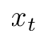
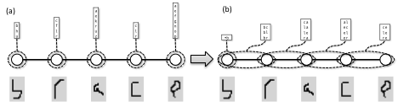
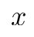
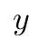
(a)
(b)
(d)
(1,1)
head
laser range
sensor
luarm
ruarm
N
S
E
W
torso
llarm
rlarm
(c)
(e)
(10,10)
Liu et al. PAMI11

Slide 3
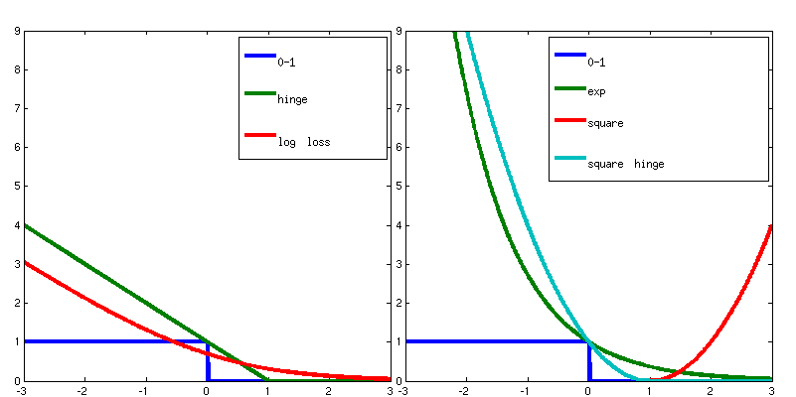
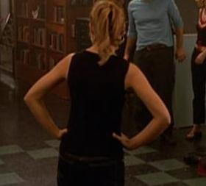
input
output
efficient inference
detected upper body

Slide 4
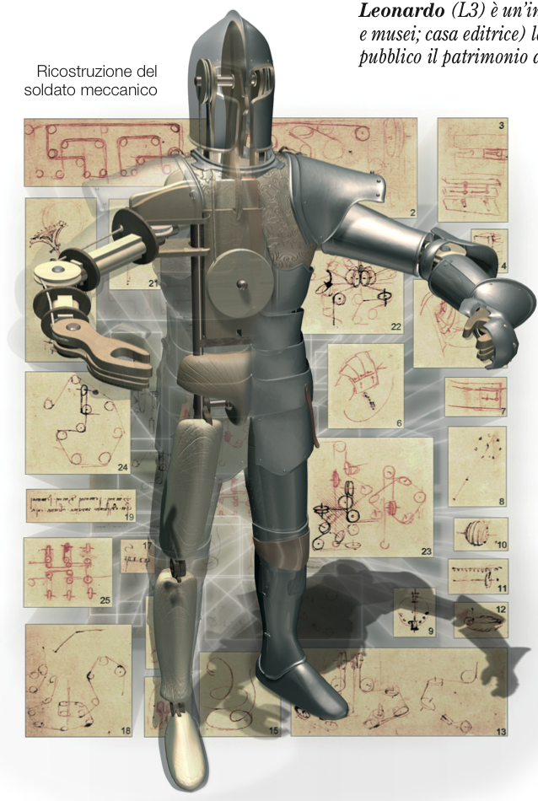
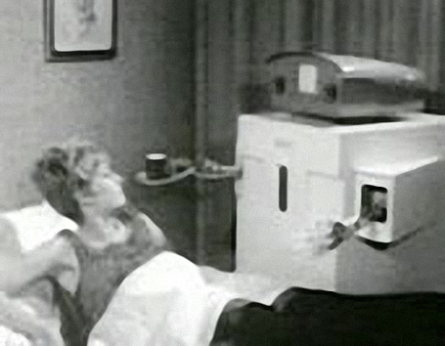

Slide 5
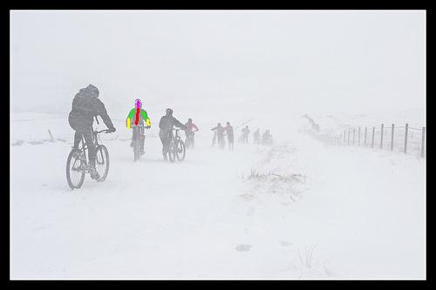
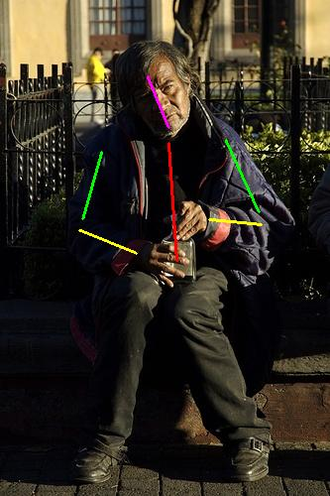
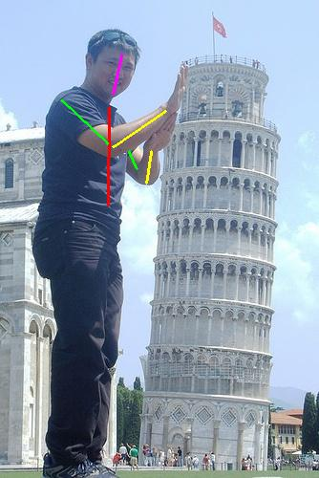
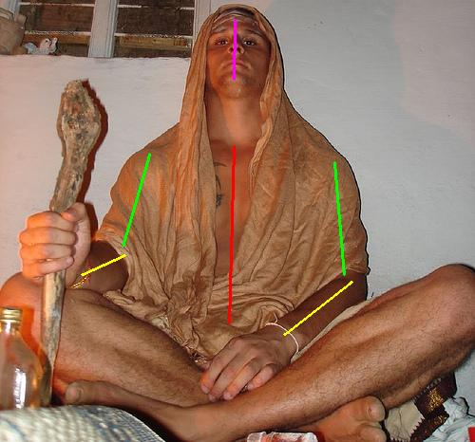
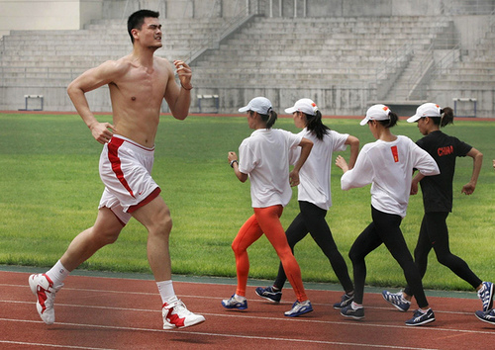
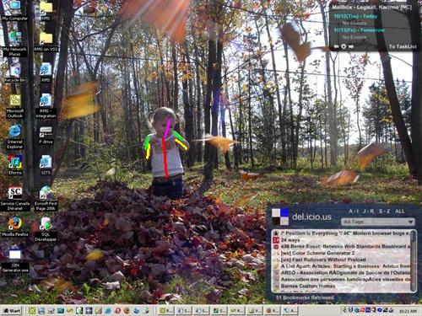
pose & viewpoint variation
lighting variation
foreshortening
intrinsic scale variations
background clutter

Slide 6
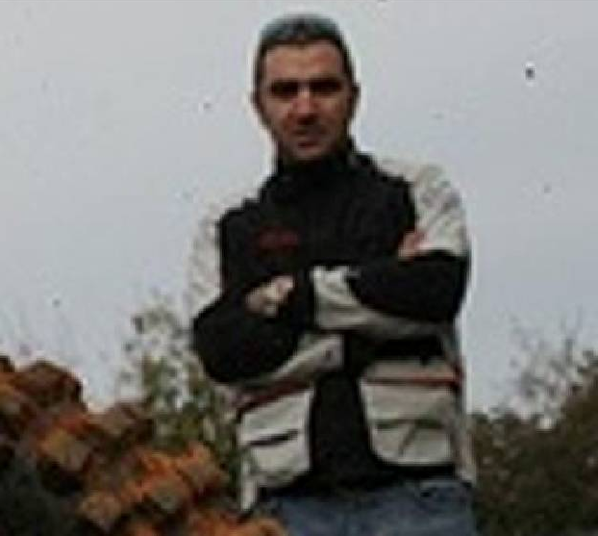
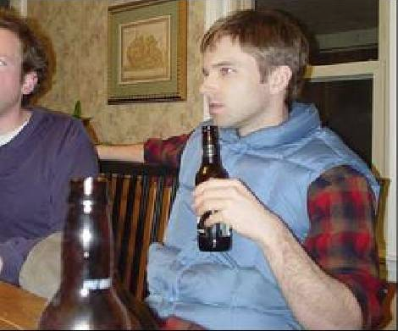
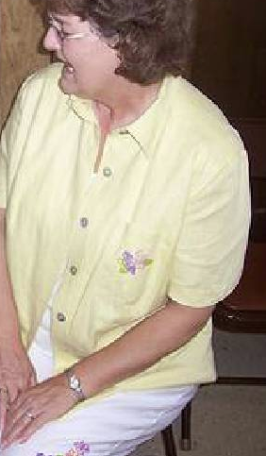
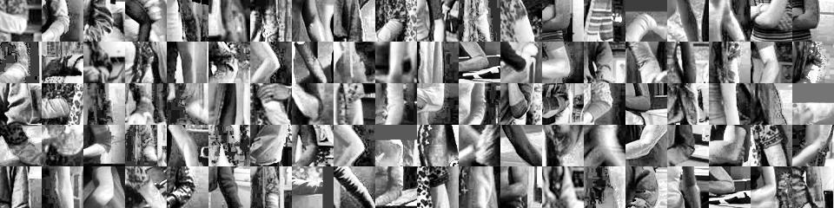
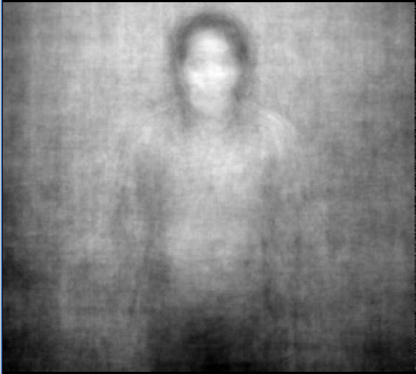
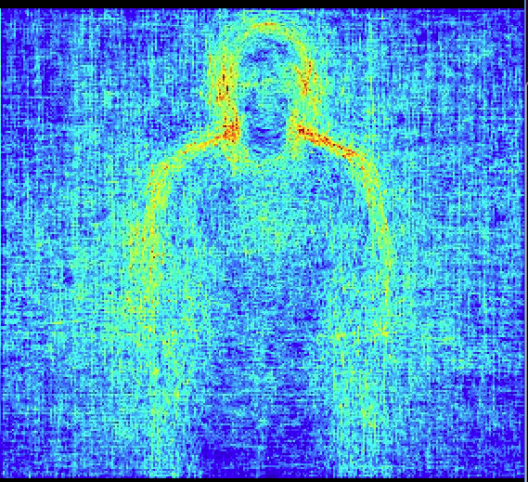
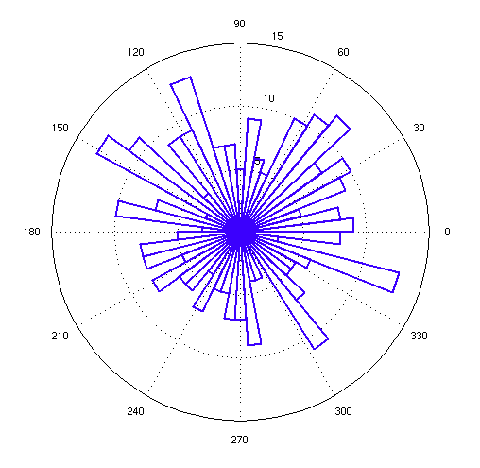
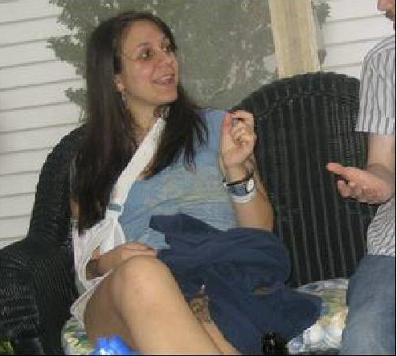
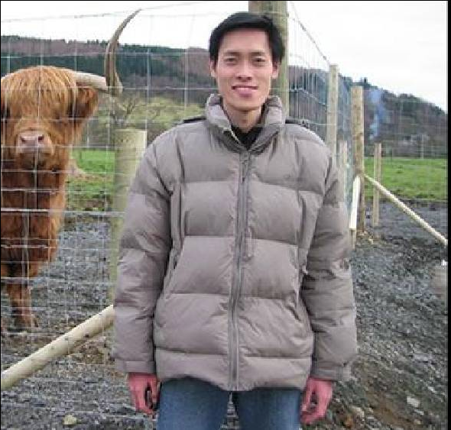
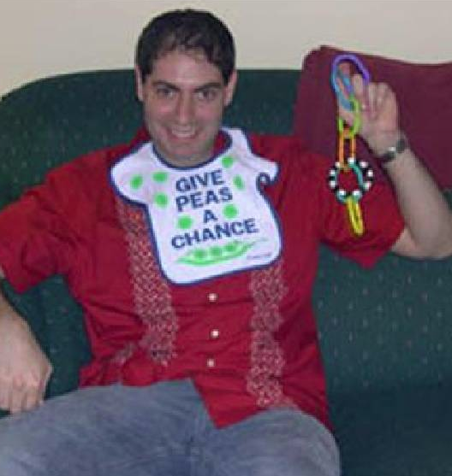
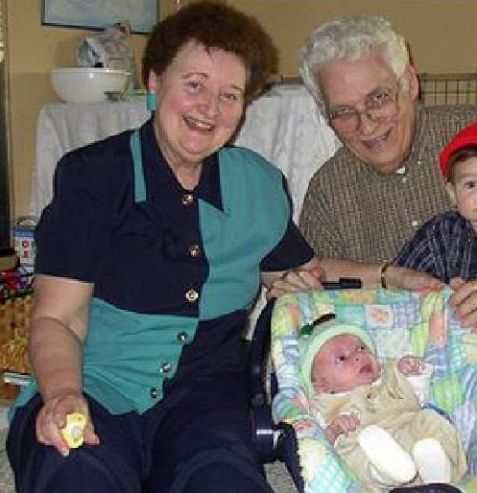
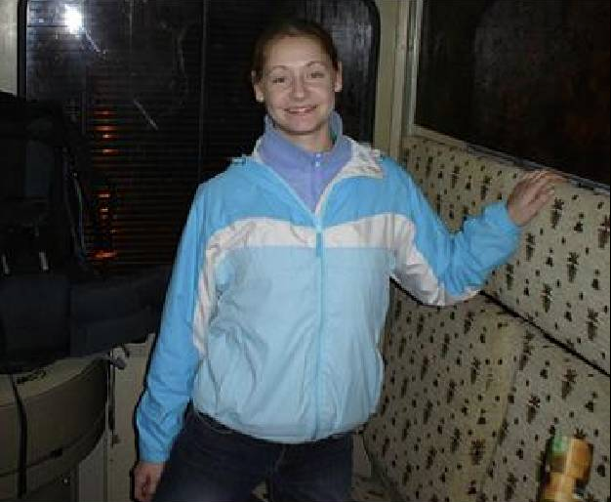
(a)
(b)
(c)
(d)

Slide 7
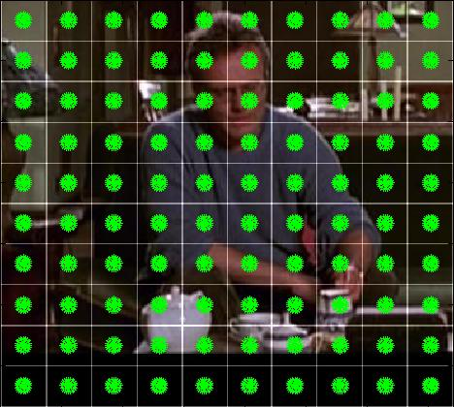
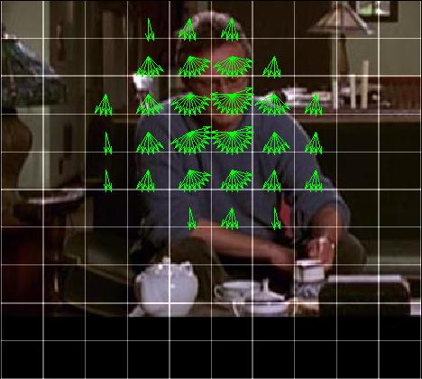
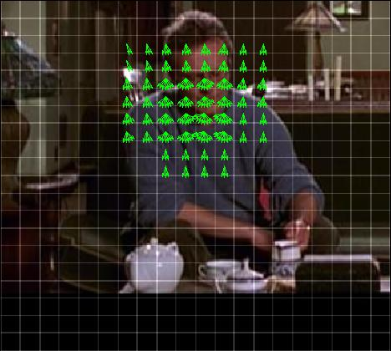
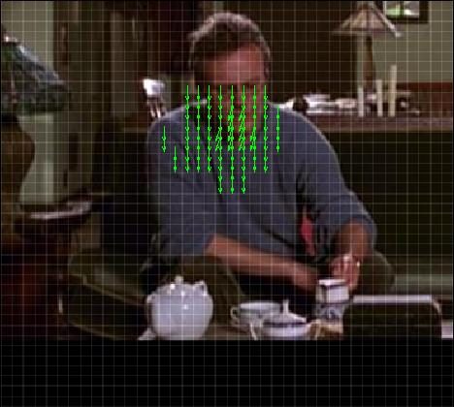
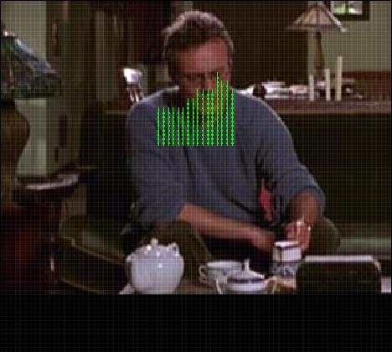
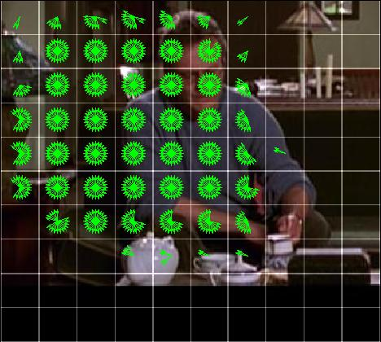
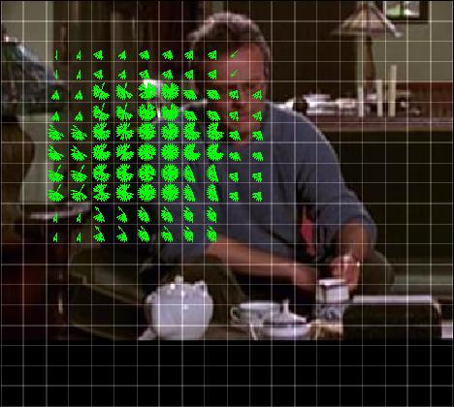
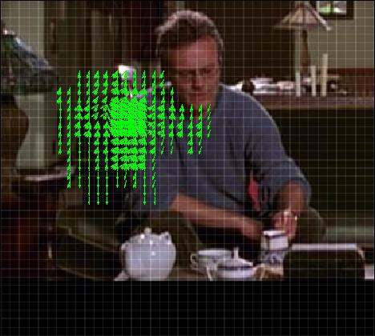
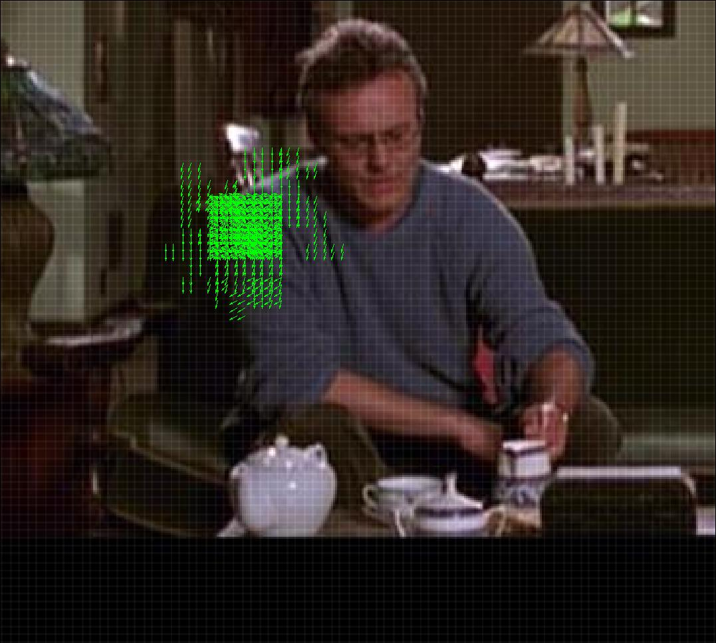
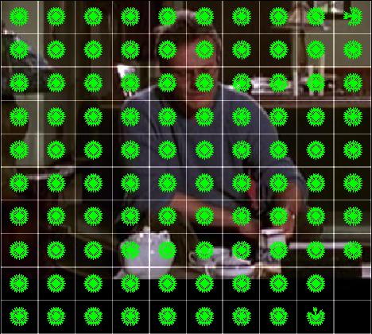
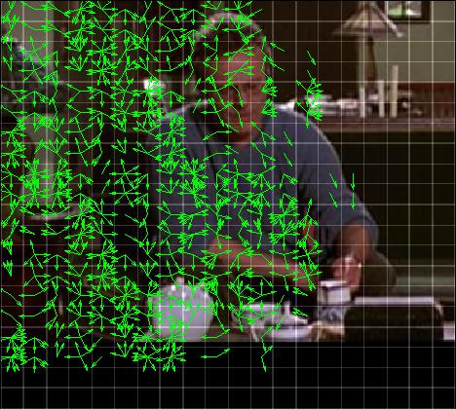
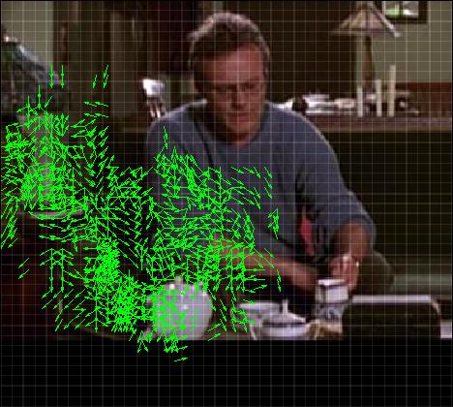
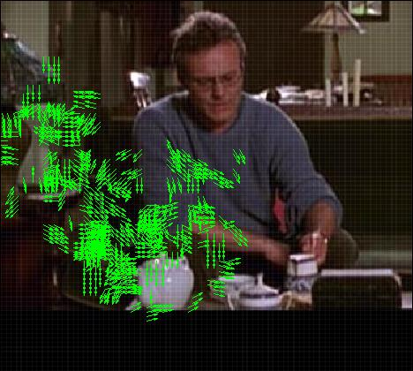
…
predict
10x10
(before pruning)
10x10
20x20
40x40
80x80
torso top
left upper arm
(shoulder)
left lower arm
(elbow)

Slide 8


Slide 9

filter & refine
Cascade level t
Cascade level t+1

Slide 10





single frame graph
ABD
A
B
ABD
ACD
ACD
C
D
CDF
CDF
CEF
E
F
incoming messages
CEF
Standard Approach
Local Linear PS
Pose Space
2D analogy
Pose Space
2D analogy
HoG
contours
geometry
ps model 2
ps 2
ps 3
ps i
…
ps model 2
ps 1
ps i+1
ps model
geometry
ps model
ps model 1
ps M-1
40 px
ps model 3
15 px
optical flow
ps model N
ps M
color
locally linear
segmentation
HoG
globally linear

Slide 11











(a) input image
(b) HoG
(c) geometry
part j
part i
(d) Ncut
(e) contours
(f) optical flow

Slide 12



(a) Prior fg/bg masks
(b) torso color vs. background
(c) face color vs. background
background
face
torso

Slide 13




Bad support
y_{i}
Good support
y_{j}
(a)
(b)
(c)
(d)

Slide 14






Buffy Stickmen v.2.1
PASCAL Stickmen v.1.0
MoviePose
VideoPose 2.0
x
shoulders
elbows
y
wrists

Slide 15

elbow accuracy
wrist accuracy
% matched joints

Slide 16


CPS feature analysis, Buffy
ESM feature analysis, VideoPose
AUC
AUC
All
All
w/o flow
geom only
w/o HoG
w/o time
baseline PS
w/o color
geom+regions
geom+color
w/o geom
w/o contours
geom+contours
w/o hand dets

Slide 17


% matched joints
% matched joints

Slide 18
wri accuracy, VideoPose
elb accuracy, VideoPose
90
90
Single Frame Agreement
80
solid lines: Ensemble of Stretchable Models
80
70
Single Frame Agreement
Single Variable Agreement
70
Dual Decomposition
60
Dual Decomposition
CPS
60
Yang & Ramanan CVPR2011
% matched joints
Wrist-Tracking Tree
50
Single Variable Agreement
Elbow Tracking Tree
50
40
Yang & Ramanan CVPR2011
40
Eichner & Ferrari BMVC09
30
CPS
Eichner & Ferrari BMVC09
30
20
20
10
15
25
30
35
40
15
25
30
35
40
pixel error
pixel error

Slide 19






image-independent pairwise scores
image-dependent
pairwise scores

Slide 21


Slide 22


Slide 23





MoviePose
Buffy Stickmen
% of examples
scaled pixel precision
PASCAL Stickmen
20 px
5px

Slide 24


Full training
12.37 models, α = 0.5
12.37 models
4.02 models
27.62 models
Cascaded training
27.62 models, α = -0.2
2.15 models
2.15 models,
α = 0.9
Yang & Ramanan
1 model
Yang & Ramanan 2011

Slide 25



input x
inference
cascade: z : c(x,z) > τ?
pose modes z

Slide 26













